Slide 1
Classification and Regression
Dr. Malak Abdullah
Computer Science Department
Jordan University of Science and Technology

Slide 2


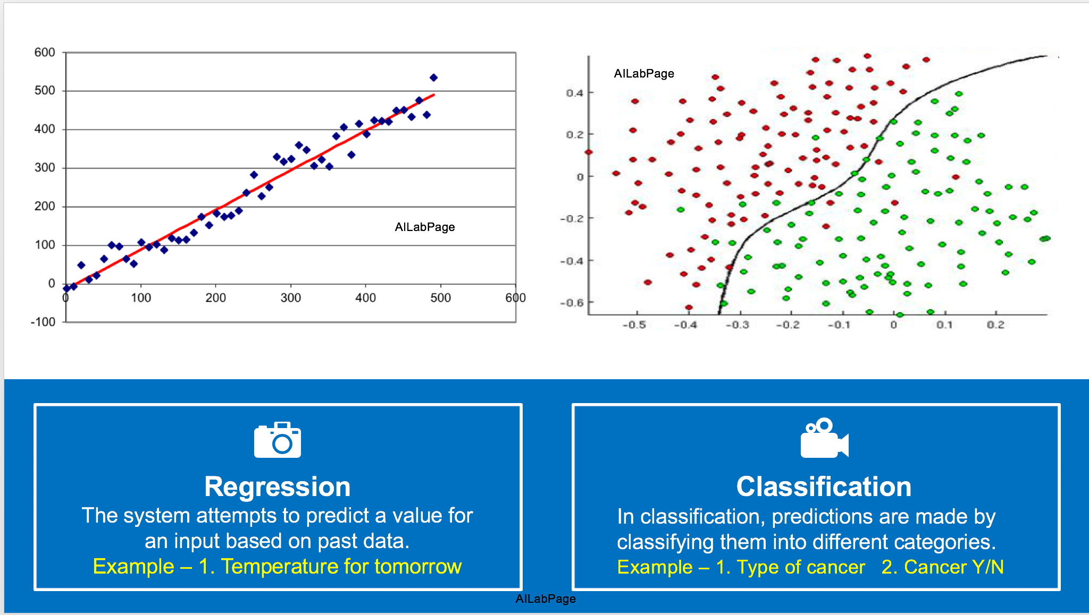

Slide 3
Classification definition
Given a collection of samples (training set)
Each sample contains a set of attributes.
Each sample also has a discrete class label
Learn a model that predicts class label as a function of the values of the attributes.
Goal: model should assign class labels to previously unseen samples as accurately as possible.
A test set is used to determine the accuracy of the model. Usually, the given data set is divided into training and test sets, with training set used to build the model and test set used to validate it.

Slide 4
Stages in a classification task
Notes:
In context of machine learning, the term “induce” is roughly equivalent to “learn” or “train”.

Slide 5

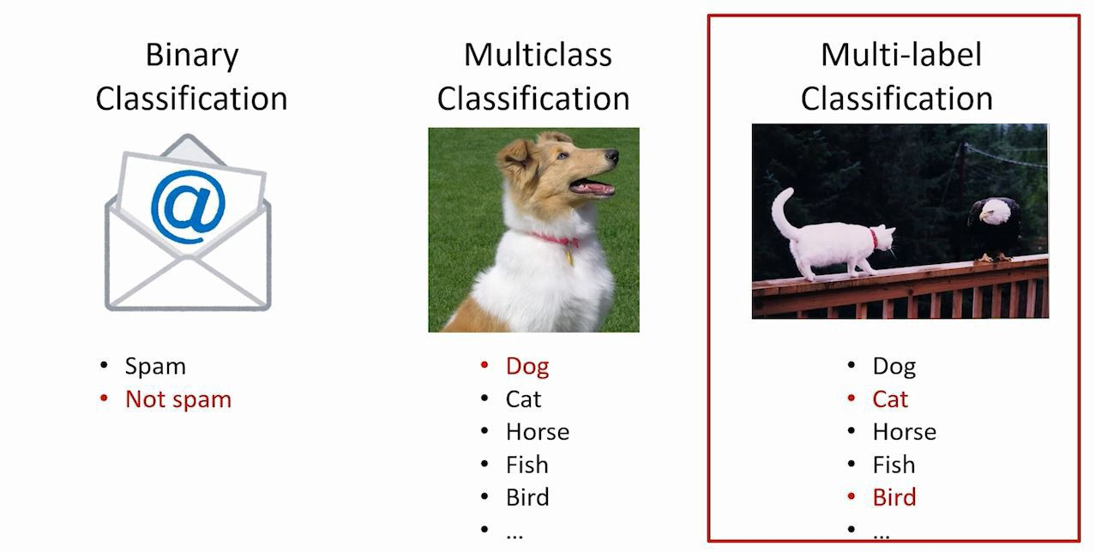
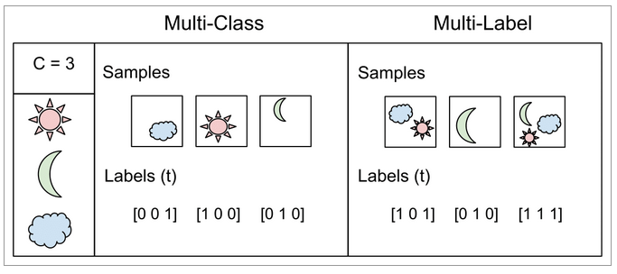
Examples of classification tasks
Two classes
Predicting tumor cells as benign or malignant
Classifying credit card transactions as legitimate or fraudulent
Multiple classes
Categorizing news stories as finance, weather, entertainment, sports, etc
Multilabel classification
Consider a face-recognition classifier: recognizes several people on the same picture
Say the classifier has been trained to recognize three faces, Alice, Bob, and Charlie; then when it is shown a picture of Alice and Charlie, it should output [1, 0, 1]
Such a classification system that outputs multiple binary labels is called a multilabel classification system.
Notes:
Examples 3 & 4 are multiclass classification problems.

Slide 6
Classification techniques
Decision trees
Rule-based methods
Logistic regression
Discriminant analysis
k-Nearest neighbor (instance-based learning)
Naïve Bayes
Neural networks
Support vector machines
Bayesian belief networks
Notes:
We will use decision trees as an example to cover many of the basic operations and issues involved in training and testing classifiers.

Slide 7
Load your data
The first step to about anything in data science is loading your data! ☺
To practice, we can load our data from Scikit-learn
The scikit-learn deals with learning information from one or more datasets that are represented as 2D arrays.
The first axis of these arrays is the samples axis, while the second is the features axis
Scikit-learn comes with a few standard datasets.
load_boston() #Load and return the boston house-prices dataset (regression)
load_iris() #Load and return the iris dataset (classification)
load_diabetes() #Load and return the diabetes dataset (regression)
load_digits([n_class]) #Load and return the digits dataset (classification)
load_linnerud() #Load and return the linnerud dataset (multivariate regression)

Slide 8
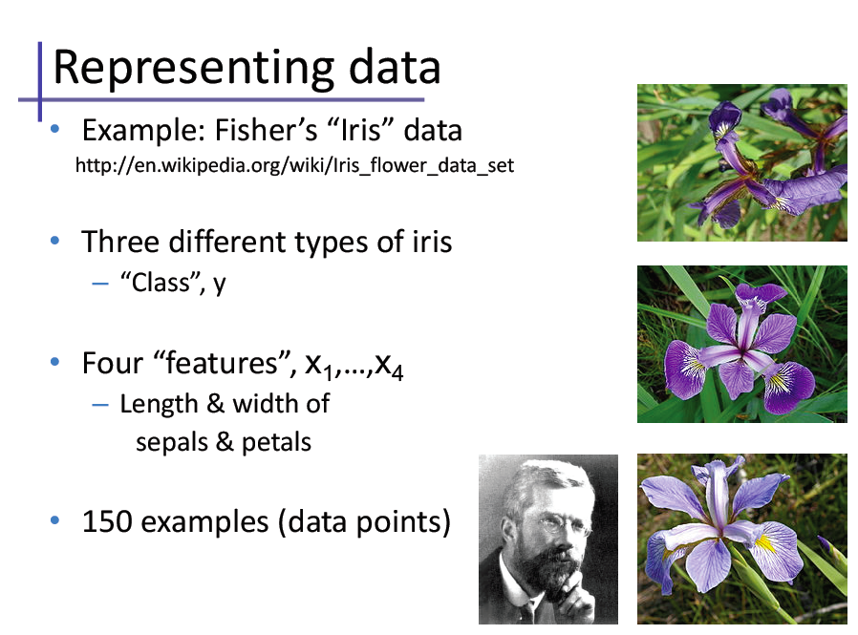
The Iris flower data set or Fisher's Iris data set is a multivariate data set introduced by the British statistician and biologist Ronald Fisher in his 1936 paper. The use of multiple measurements in taxonomic problems as an example of linear discriminant analysis.
ازهار السوسن

Slide 9
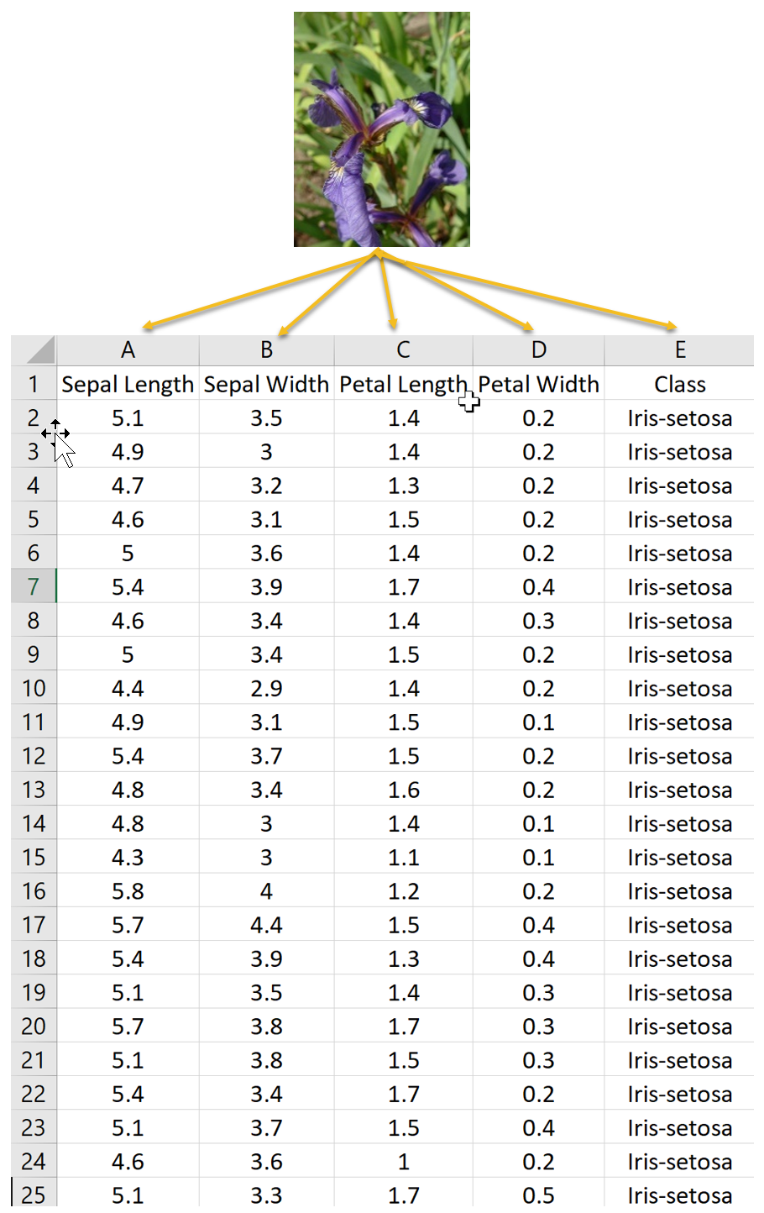

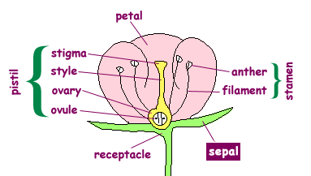

Slide 10
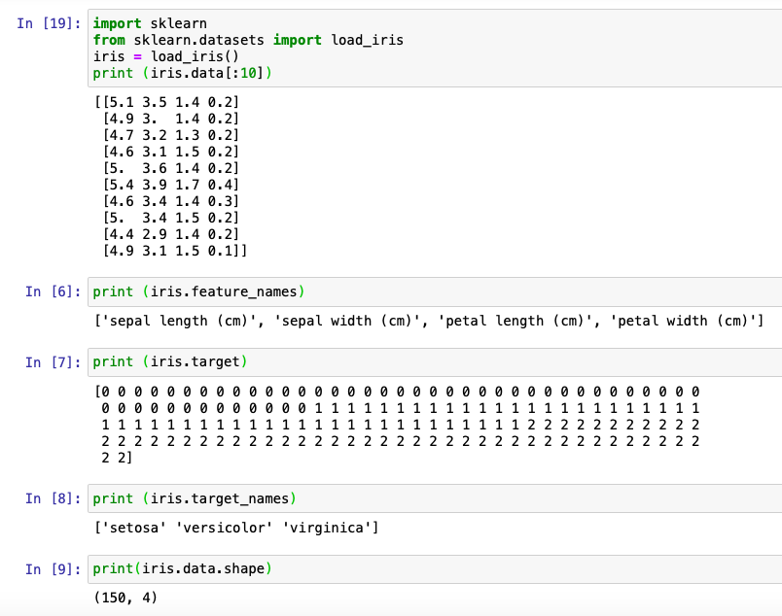

Slide 11
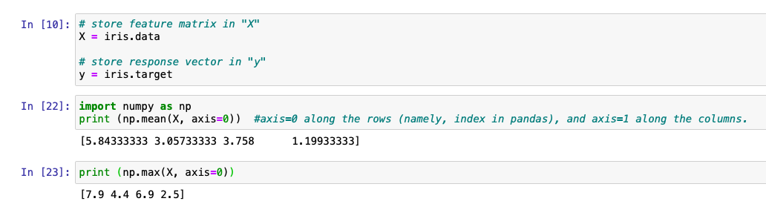

Slide 12
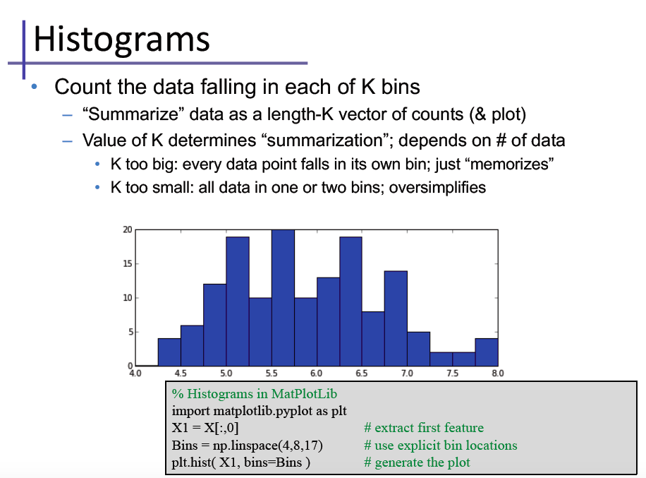

Slide 13
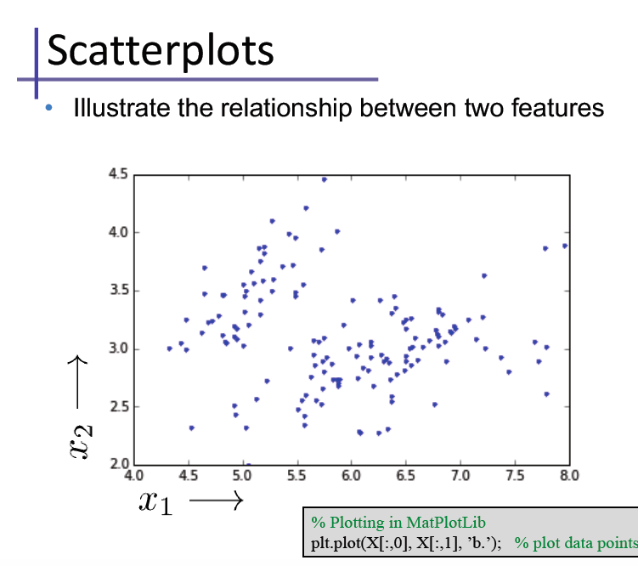
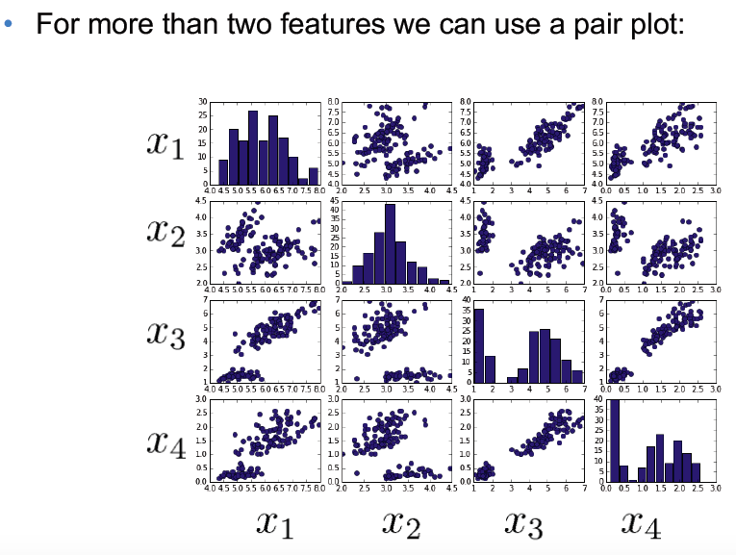

Slide 14
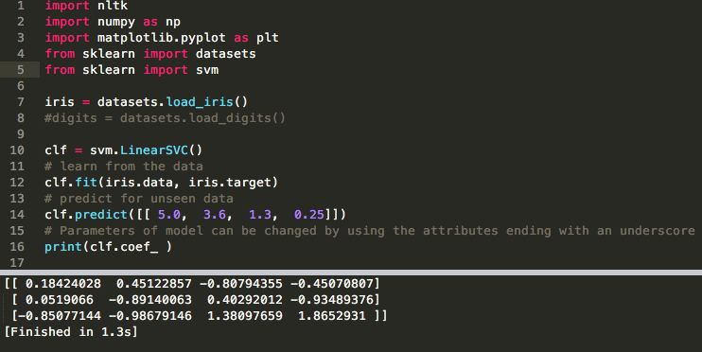
Train the model

Slide 15
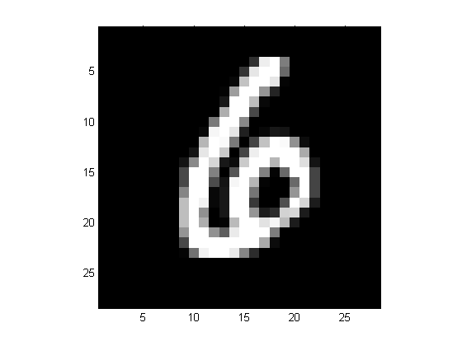
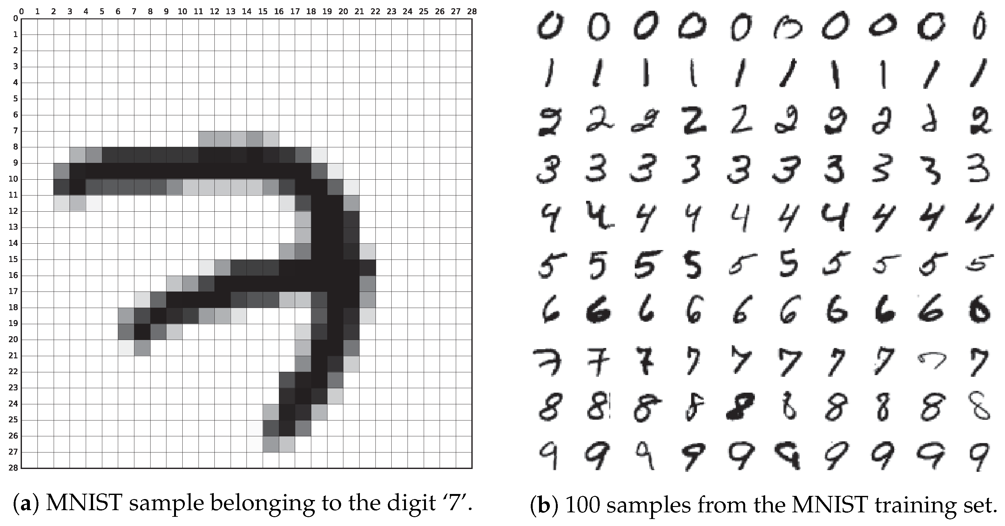
MNIST database of handwritten digits
Gray-scale images, 28 x 28 pixels.
10 classes, labels 0 through 9.
Training set of 60,000 samples.
Test set of 10,000 samples.
Subset of a larger set available from NIST.

Slide 16
Coding
We will be using MNIST dataset, which is a set of 70,000 small images of digits handwritten by high school students and employees of the US Census Bureue.
Each image is labeled with the digit it represents.
This dataset is The “hello world” for Machine learning
Each digit size-normalized and centered in a fixed-size image.
Good database for people who want to try machine learning techniques on real-world data while spending minimal effort on preprocessing and formatting.
http://yann.lecun.com/exdb/mnist/
You can find the dataset as Training 60,000 and test 10,000 on: https://www.python-course.eu/neural_network_mnist.php

Slide 17
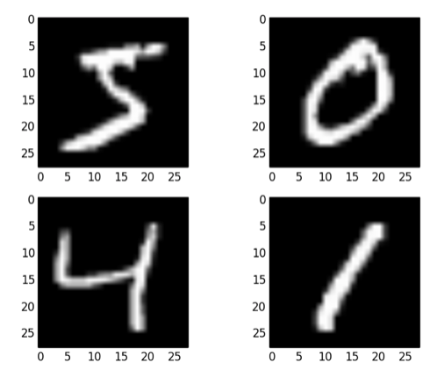
Example
28 X 28 = 784 features

Slide 18
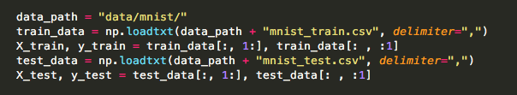
Reading data
Train 60,000 and Test 10,000

Slide 19
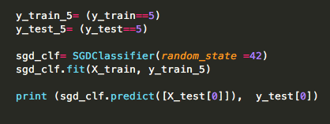
Testing number 5
Distinguishing between just two classes, 5 and not 5
# True for all 5s, False for all other digits

Slide 20
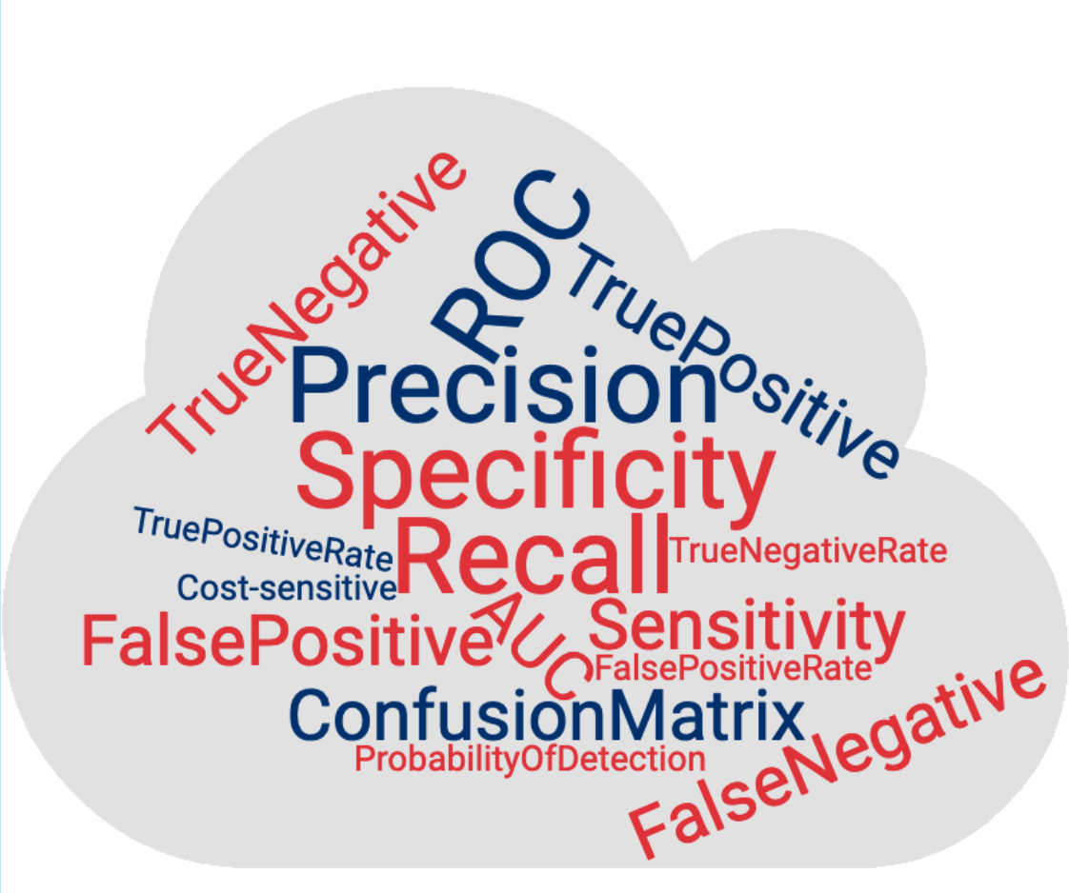
Producing useful models: topics
Validation
Generalization
Overfitting, underfitting
Measuring classifier performance

Slide 21
Model validation
Every (useful) model offers choices in one or more of:
model structure
e.g. number of nodes and connections in NN
types and numbers of parameters
e.g. coefficients, weights, etc
Furthermore, the values of most of these parameters will be modified (optimized) during the model training process.
Suppose the test data somehow influences the choice of model structure, or the optimization of parameters …

Slide 22

Model validation
The one commandment of machine learning
TRAIN
on
TEST

Slide 23
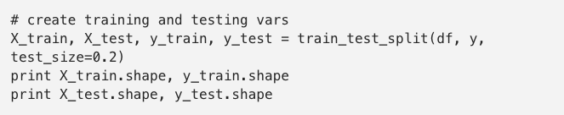
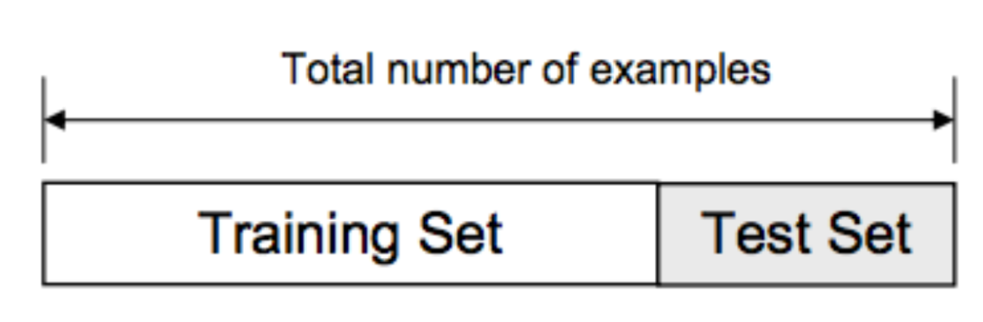
Split the data
We usually split our data into two subsets: training data and testing data (and sometimes to three: train, validate and test), and fit our model on the train data, in order to make predictions on the test data.

Slide 24
Model validation
Divide available labeled data into three sets:
Training set:
Used to drive model building and parameter optimization
Validation set
Used to gauge status of generalization error
Results can be used to guide decisions during training process
typically used mostly to optimize small number of high-level meta parameters, e.g. regularization constants; number of gradient descent iterations
Test set
Used only for final assessment of model quality, after training + validation completely finished

Slide 25
Validation strategies
Holdout (train-test-split)
is when you split up your dataset into a ‘train’ and ‘test’ set. The training set is what the model is trained on, and the test set is used to see how well that model performs on unseen data.
A common split when using the hold-out method is using 80% of data for training and the remaining 20% of the data for testing.
Cross-validation
Cross-validation or ‘k-fold cross-validation’ is when the dataset is randomly split up into ‘k’ groups. One of the groups is used as the test set and the rest are used as the training set. The model is trained on the training set and scored on the test set. Then the process is repeated until each unique group as been used as the test set.

Slide 26
Validation strategies
Holdout
Pro: results in single model that can be used directly in production
Con: can be wasteful of data
Con: a single static holdout partition has the potential to be unrepresentative and statistically misleading
Cross-validation and leave-one-out (LOO)
Con: do not lead directly to a single production model
Pro: use all available data for evaluation
Pro: many partitions of data, helps average out statistical variability

Slide 27
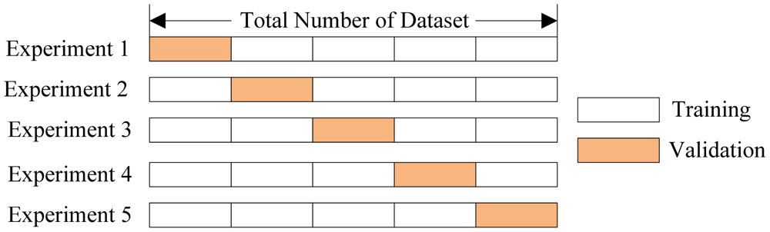
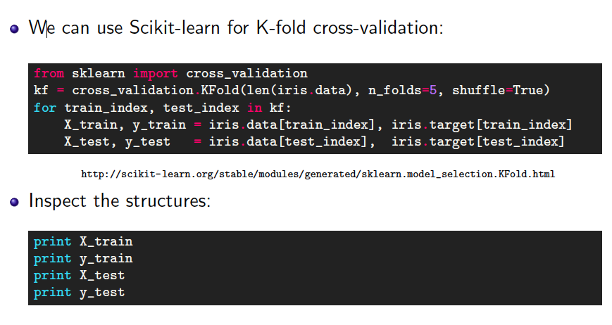
Cross Validation
Cross-validation is one of several approaches for estimating how well the model you've just learned from some training data is going to perform on future as-yet-unseen data.
We’ll talk about k-fold cross-validation,

Slide 28
Generalization
Definition: model does a good job of correctly predicting class labels of previously unseen samples
Generalization is typically evaluated using a test set of data that was not involved in the training process
Evaluating generalization requires:
Correct labels for test set are known.
A quantitative measure (metric) of tendency for model to predict correct labels.

Slide 29
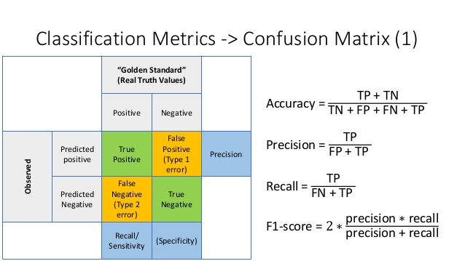
Metrics for classifier performance
Notes:
Metrics for classifier performance can be used on any labeled partition of the data: training, validation, or test.

Slide 30
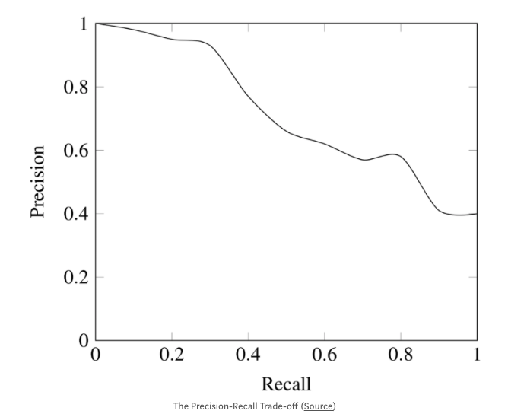
Trade-off
While recall expresses the ability to find all relevant instances in a dataset, precision expresses the proportion of the data points our model says was relevant actually were relevant.

Slide 31
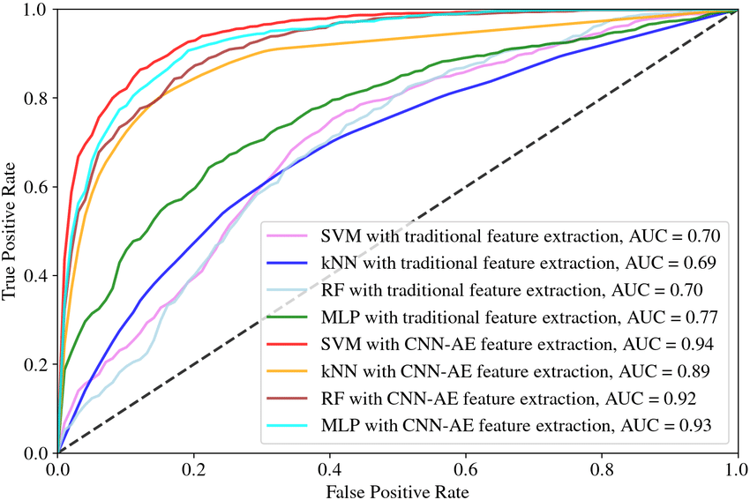
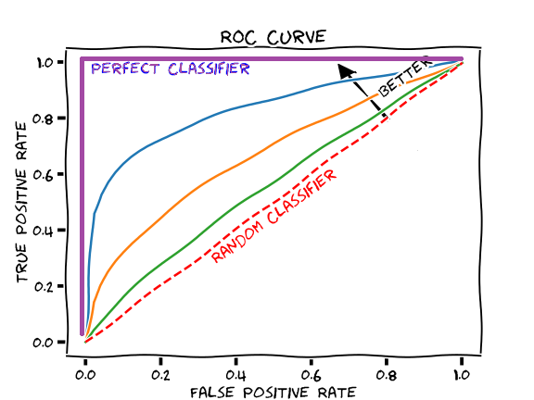
ROC AUC
A receiver operating characteristic curve→ ROC curve
Area under the ROC Curve → AUC

Slide 32
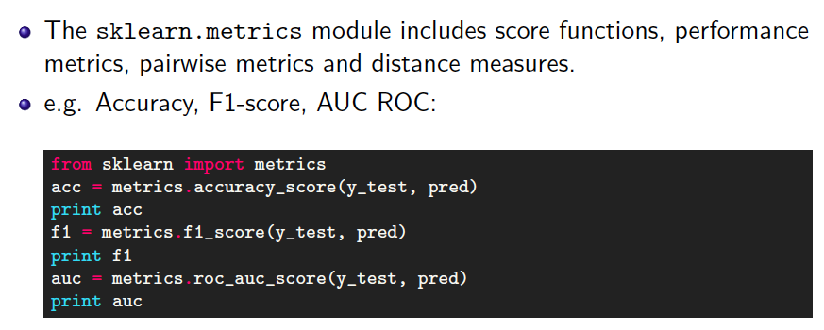
Coding…Evaluation

Slide 33
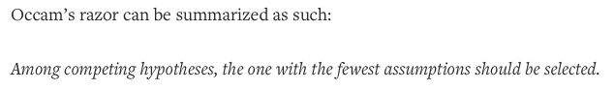
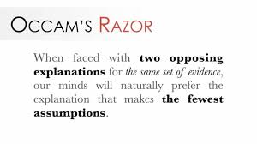
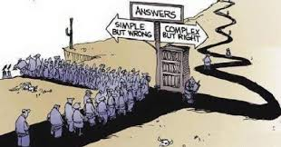
Occam’s Razor
Given two models with similar generalization errors, one should prefer the simpler model over the more complex model.
For complex models, there is a greater chance it was fitted accidentally by errors in data.
Model complexity should therefore be considered when evaluating a model.

Slide 34
Regression

Slide 35
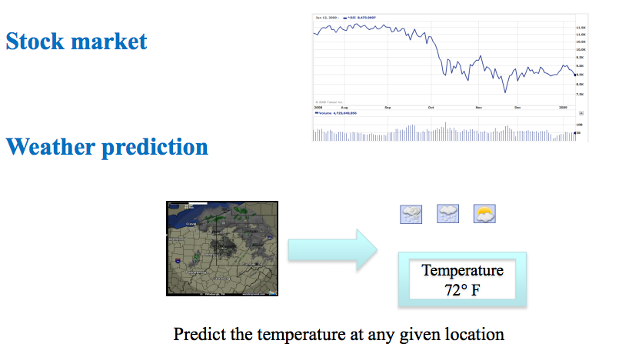
Regression examples

Slide 36
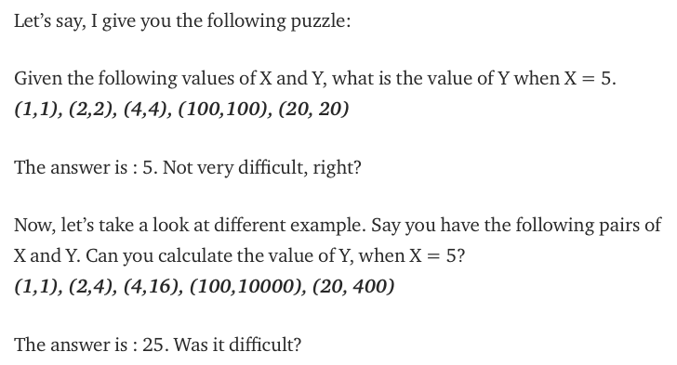
Before we start!
The relationship between X and Y is Y = X
The relationship is Y = X*X

Slide 37
Overall, machine learning works in the same way!
Your computer looks at some examples and then tries to identify “the most suitable” relationship between the sets X and Y.
Using this identified relationship, it will try to predict (or more) for new examples for which you don’t know Y.

Slide 38
What is Regression?
Regression is usually termed as determining relationship(s) between two or more variables.
For example, in the above two examples, X and Y are the variables.
X is termed as the independent variable and Y is termed as the dependent variable and Y has a continuous range (unlike classification where Y is discrete).
If we had multiple input attributes (e.g. x1, x2, x3, etc.) This would be called multiple linear regression.

Slide 39
Types of Regression Models
1 Explanatory Variable
Regression
2+ Explanatory Variables
Models
Simple
Multiple
Non-
Non-
Linear
Linear
Linear
Linear
Notes:
24
This teleology is based on the number of explanatory variables & nature of relationship between X & Y.

Slide 40
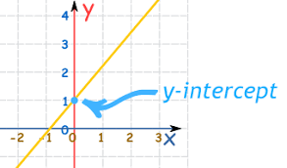
Simple Linear Regression
Simple Linear Regression (SLR) is termed as simple because there is only independent variable.
For example, consider you only have date and stock prices of a company, you can fit a regression model to the date (as X) and stock price (as Y).
The model which look something like this: Price = m*Date + c
The equation resembles that of a line with ‘m’ slope and ‘c’ y-intercept.
The equation of any straight line, called a linear equation, can be written as: y = mx + c, where m is the slope of the line and c is the y-intercept. The y-intercept of this line is the value of y at the point where the line crosses the y axis.

Slide 41
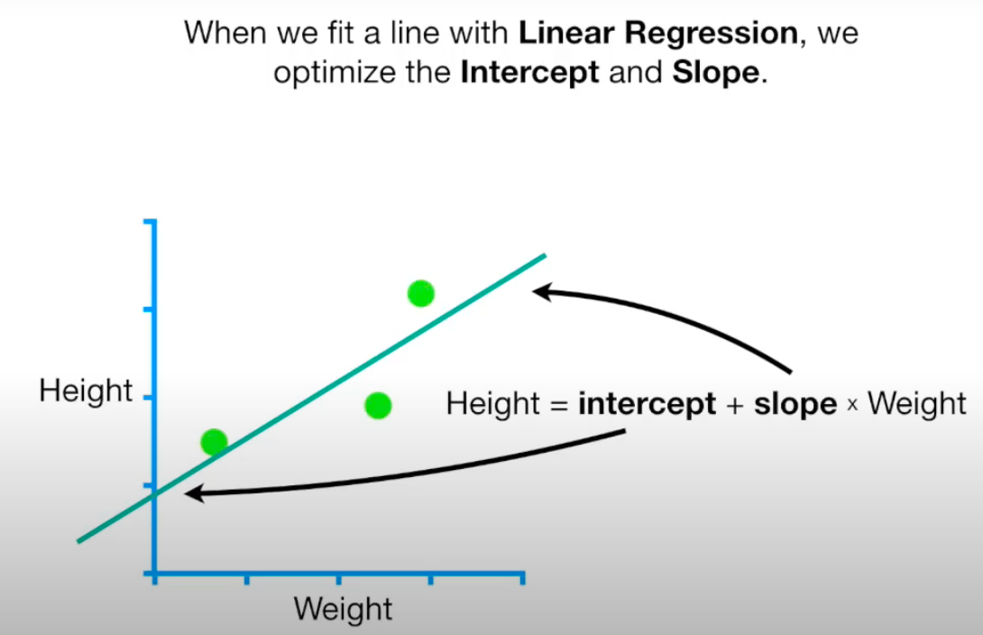
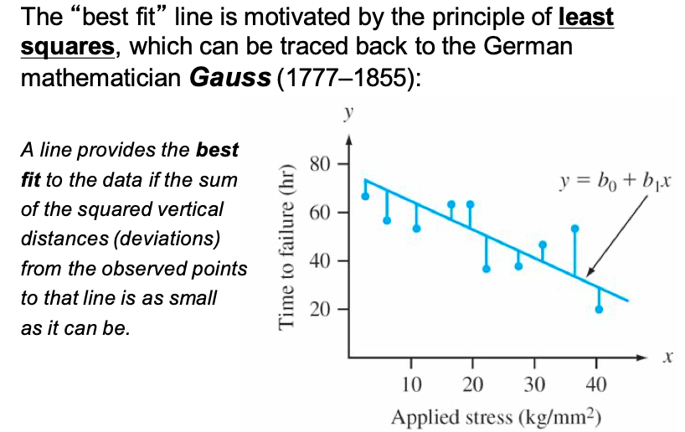
The most suitable values of ‘m’ and ‘c’ are the ones that produce the least error across all given X and Y.
Take the sum of absolute difference of Y` and Y for all seen X, the values which have the least sum are the most suitable values.
There are infinite values of ‘m’ and infinite values of ‘c’. Which one to choose!! The answer to this question is Gradient Descent algorithm.

Slide 42
a quick shortcut for calculating the coefficients!
we want to model our data as follows:
y = B0 + B1 * x
This is a line where y is the output variable we want to predict, x is the input variable we know and B0 and B1 are coefficients that we need to estimate that move the line around.
B0 (the intercept of the true regression line): The average value of Y when x is zero.
Technically, B0 is called the intercept because it determines where the line intercepts the y-axis. In machine learning we can call this the bias, because it is added to offset all predictions that we make. The B1 term is called the slope because it defines the slope of the line or how x translates into a y value before we add our bias.
Simple linear regression is the simplest form of regression and the most studied.
There is a shortcut that you can use to quickly estimate the values for B0 and B1.

Slide 43
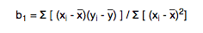

a quick shortcut for calculating the coefficients!
We can start off by estimating the value for B1 as:
B1 = sum((xi-mean(x)) * (yi-mean(y))) / sum((xi – mean(x))^2)
We can calculate B0 using B1 and some statistics from our dataset, as follows:
B0 = mean(y) – B1 * mean(x)

Slide 44
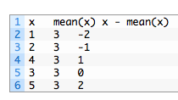
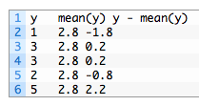
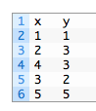
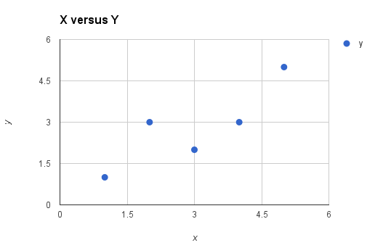
Example
Now we need to calculate the error of each variable from the mean.
mean(x) = 3
mean(y) = 2.8
x - mean(x) y - mean(y) Multiplication
-2 -1.8 3.6
-1 0.2 -0.2
1 0.2 0.2
0 -0.8 0
2 2.2 4.4
x - mean(x) squared
-2 4
-1 1
1 1
0 0
2 4
Sum =8
B1 = 8 / 10
B1 = 0.8
B0 = mean(y) – B1 * mean(x)
B0 = 2.8 – 0.8 * 3
B0 = 0.4
Sum =10

Slide 45
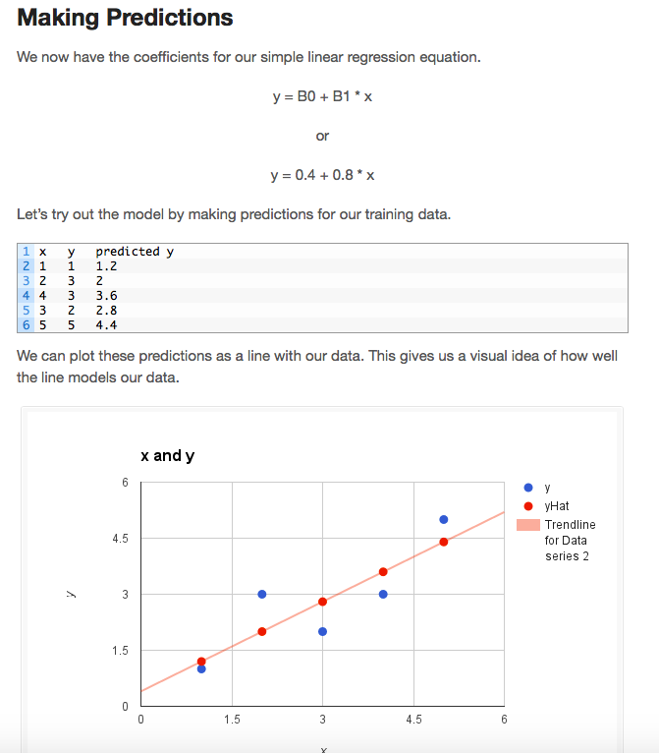

Slide 46
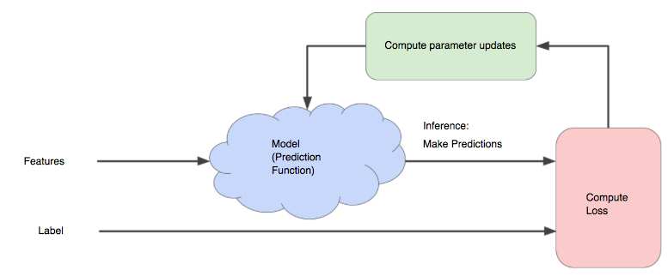
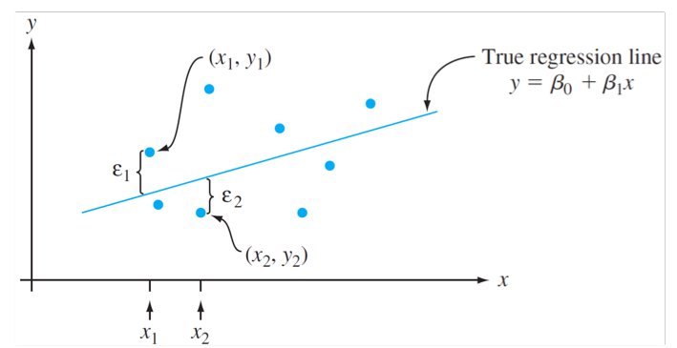
Just to check if you understand that
Once we find the best B₁ and B₀ values, we get the best fit line. So when we are finally using our model for prediction, it will predict the value of y for the input value of x.
How to update B₁ and B₀ values to get the best fit line ?

Slide 47
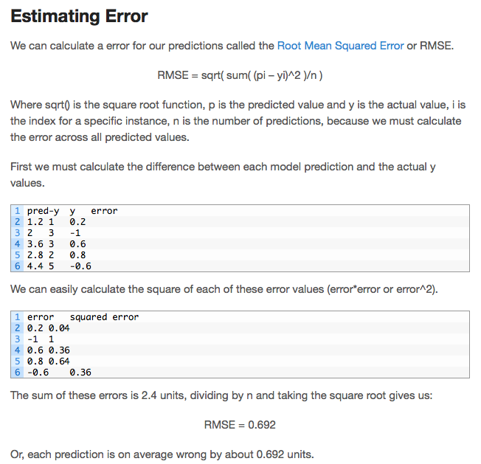
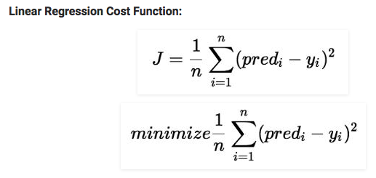
Cost Function (J):
Cost function(J) of Linear Regression can be the Root Mean Squared Error (RMSE) between predicted y value (pred) and true y value (y)
or

Slide 48
How to choose θ₁ and θ₂
To minimize the cost function, the model needs to have the best value of θ₁ and θ₂.
Initially model selects θ₁ and θ₂ values randomly and then iteratively update these value in order to minimize the cost function until it reaches the minimum.
By the time model achieves the minimum cost function, it will have the best θ₁ and θ₂ values.
Using these finally updated values of θ₁ and θ₂ in the hypothesis equation of linear equation, model predicts the value of x in the best manner it can.
B₀ and B₁ ₌ θ₁ and θ₂

Slide 49
Multivariate regression
What if we have several inputs?
- Stock prices for Yahoo, Microsoft and Ebay for the Google prediction task
This becomes a multivariate regression problem
Again, its easy to model:
y = B₀ + B₁x₁+ … + B_{k}x_{k} + ε
Multiple Linear Regression

Slide 50
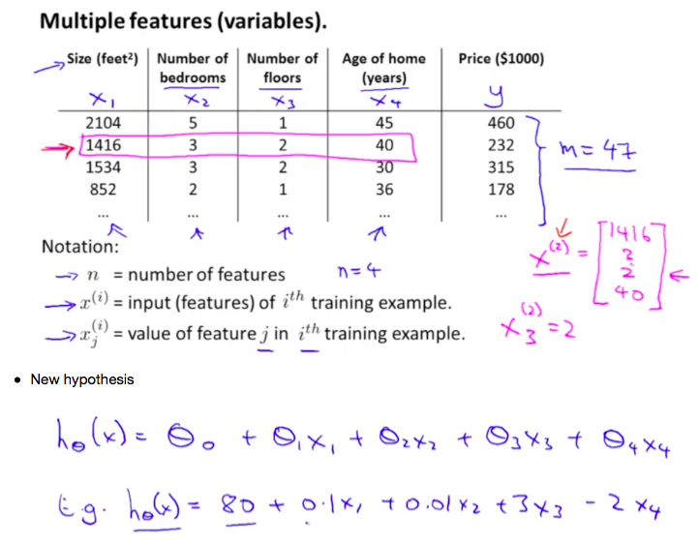

Slide 51
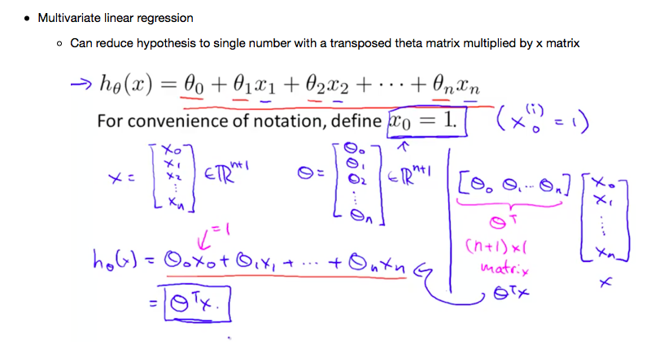

Slide 52
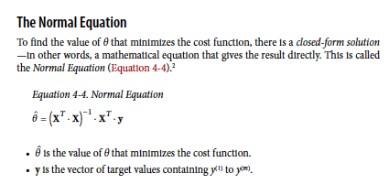
Easy way to minimize the cost is:

Slide 53
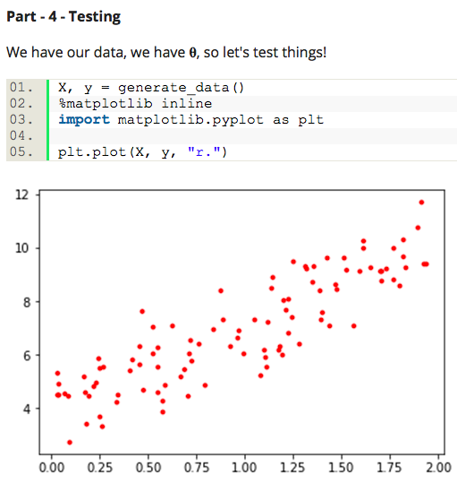
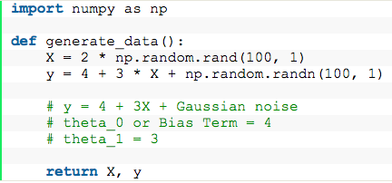
An Example
Data generation
from numpy.linalg import inv
def get_best_param(X, y):
X_transpose = X.T
best_params = inv(X_transpose.dot(X)).dot(X_transpose).dot(y)
# normal equation
# theta_best = (X.T * X)^(-1) * X.T * y
return best_params # returns a list
X_b = np.c_[np.ones((100, 1)), X]
# set bias term to 1 for each sample
params = get_best_param(X_b, y)
print(params)
array([[ 3.94204397],
[ 3.08256508]])

Slide 54


plt.plot(test_X, prediction, "r--")
plt.plot(X, y, "b.")
plt.axis([0, 2, 0, 15])
# x axis range 0 to 2, y axis range 0 to 15
plt.show()

Slide 55

SKLearn

Slide 56
Gradient Descent
The goal is to minimize the cost function.
Minimizing any function means finding the deepest valley in that function.
means getting to the lowest error value possible or increasing the accuracy of the model.
We increase the accuracy by iterating over a training data set while tweaking the parameters (the weights and biases) of our model.
Do you remember the Calculus course?!?!
Using calculus, we know that the slope of a function is the derivative of the function with respect to a value. This slope always points to the nearest valley!
Gradient Descent is a very generic optimization algorithm capable of finding optimal solutions to a wide range of problems.

Slide 57

Once the gradient is zero, you have reached a minimum!

Slide 58


Stop! Do you know how to do that?
We want to make f(x, y)=0

Slide 59

So, if we repeat the above process for 4000 times we will get the value of x = -2 and y = 2.0 leading us to give the output of our function f(x, y) = 0. So we have got the expected values of x and y that cause our function to give the minimum value of 0.
would give an output of 7.99 which is less than 8 ☺

Slide 60



Example
Weight 0.5 Height 1.4
Weight 2.3 Height 1.9
Weight 2.9 Height 3.2
We will use 0.64 for slope for now to find intercept

Slide 61




Slide 62









Slide 63






Slide 64





Slide 65




Slide 66





Watch this to see the rest of the lecture https://www.youtube.com/watch?v=sDv4f4s2SB8

Slide 67
Learning rate
Now that we have found the direction we need to find how much to nudge the weight. Here, we use the Learning Rate.
The Learning Rate is called a hyper-parameter.
A hyper-parameter is a value required by your model which we really have very little idea about.
These values can be learned mostly by trial and error. There is no, one-fits-all for hyper-parameters.
This Learning Rate can be thought of as a, “step in the right direction,” where the direction comes from dJ/dw.
If the learning rate is too small, then the algorithm will have to go through many iterations to converge, which will take a long time

Slide 68



Problems with Gradient Descent

Slide 69

Important!
When using Gradient Descent, you should ensure that all features have a similar scale (e.g., using Scikit-Learn’s StandardScaler class), or else it will take much longer to converge.
Fortunately, the MSE cost function for a Linear Regression model happens to be a convex function, which means that if you pick any two points on the curve, the line segment joining them never crosses the curve. This implies that there are no local minima, just one global minimum.
It is also a continuous function with a slope that never changes abruptly

Slide 70


Implementing GD
To implement Gradient Descent, you need to compute the gradient of the cost function with regards to each model parameter θj.
In other words, you need to calculate how much the cost function will change if you change θj just a little bit.
This is called a partial derivative.
compute the partial derivative of the cost function with regards to parameter θj
Gradient Descent step:

Slide 71
Types of Gradient Descent
There are three popular types of Gradient Descent, that mainly differ in the amount of data they use:
Batch Gradient Descent: calculates the error for each example within the training dataset, but only after all training examples have been evaluated, the model gets updated. This whole process is like a cycle and called a training epoch. It requires that the entire training dataset is in memory and available to the algorithm.
Stochastic Gradient Descent (SGD): just picks a random instance in the training set at every step and computes the gradients based only on that single instance. So once the algorithm stops, the final parameter values are good, but not optimal.
Mini Batch Gradient Descent: it’s a combination of the concepts of SGD and Batch Gradient Descent. It simply splits the training dataset into small batches and performs an update for each of these batches. Therefore, it creates a balance between the robustness of stochastic gradient descent and the efficiency of batch gradient descent.

Slide 72


Example!

Slide 73

Step 1: Initialize the weights(a & b) with random values and calculate Error
Step 2: Calculate the gradient i.e. change in error when the weights (a & b) are changed by a very small value from their original randomly initialized value. This helps us move the values of a & b in the direction in which error is minimized.
Step 3: Adjust the weights with the gradients to reach the optimal values where error is minimized
Step 4: Use the new weights for prediction and to calculate the new error
Step 5: Repeat steps 2 and 3 till further adjustments to weights doesn’t significantly reduce the Error
our objective is to find optimal a, b that minimizes the error between actual and predicted values

Slide 74


Standardize the data

Slide 75


Slide 76

Step 3:

Slide 77



Polynomial Regression
Linear regression requires the relation between the dependent variable and the independent variable to be linear. What if the distribution of the data was more complex as shown in the below figure? Can linear models be used to fit non-linear data? How can we generate a curve that best captures the data as shown below?

Slide 78


To overcome under-fitting, we need to increase the complexity of the model.
from sklearn.linear_model import LinearRegression
model = LinearRegression()
model.fit(x, y)
y_pred = model.predict(x)

Slide 79


A simple way to do this is to add powers of each feature as new features, then train a linear model on this extended set of features. This technique is called Polynomial Regression.
This is still considered to be linear model as the coefficients/weights associated with the features are still linear. x² is only a feature. However, the curve that we are fitting is quadratic in nature.
To convert the original features into their higher order terms we will use the PolynomialFeatures class provided by scikit-learn. Next, we train the model using Linear Regression.
The linear model,
can be transformed to
from sklearn.preprocessing import PolynomialFeatures

Slide 80

Learning Curves
If you perform high-degree Polynomial Regression, you will likely fit the training data much better than with plain Linear Regression. But?!?!?

Slide 81
Regularized Linear Models
A good way to reduce overfitting is to regularize the model
A simple way to regularize a polynomial model is to reduce the number of polynomial degrees.
We will now look at Ridge Regression, Lasso Regression, and Elastic Net
“Ridge” is a fancy name for L2-regularization, “LASSO” means L1-regularization, “ElasticNet” is a ratio of L1 and L2 regularization.
We will also look at Early Stopping and Logistic Regression

Slide 82

Ridge
Ridge regression shrinks the regression coefficients, so that variables, with minor contribution to the outcome, have their coefficients close to zero.
The shrinkage of the coefficients is achieved by penalizing the regression model with a penalty term called L2-norm, which is the sum of the squared coefficients.
The amount of the penalty can be fine-tuned using a constant called lambda (λ or ⍺). Selecting a good value for ⍺ is critical.
When ⍺ =0, the penalty term has no effect, and ridge regression will produce the classical least square coefficients. However, as ⍺ increases to infinite, the impact of the shrinkage penalty grows, and the ridge regression coefficients will get close zero.
Ridge regression shrinks the coefficients towards zero, but it will not set any of them exactly to zero. The lasso regression is an alternative that overcomes this drawback.

Slide 83



Lasso
Lasso stands for Least Absolute Shrinkage and Selection Operator. It shrinks the regression coefficients toward zero by penalizing the regression model with a penalty term called L1-norm, which is the sum of the absolute coefficients.
In the case of lasso regression, the penalty has the effect of forcing some of the coefficient estimates, with a minor contribution to the model, to be exactly equal to zero. This means that, lasso can be also seen as an alternative to the subset selection methods for performing variable selection in order to reduce the complexity of the model.
As in ridge regression, selecting a good value of ⍺ for the lasso is critical.
Ridge
LASSO
OR

Slide 84

Elastic Net
Elastic Net produces a regression model that is penalized with both the L1-norm and L2-norm. The consequence of this is to effectively shrink coefficients (like in ridge regression) and to set some coefficients to zero (as in LASSO).

Slide 85

Early stopping
Stop training as soon as the validation error reaches a minimum.

Slide 86

Logistic
Logistic Regression (also called Logit Regression) is commonly used to estimate the probability that an instance belongs to a particular class (e.g., what is the probability that this email is spam?).
If the estimated probability is greater than 50%, then the model predicts that the instance belongs to that class (called the positive class, labeled “1”), or else it predicts that it does not (i.e., it belongs to the negative class, labeled “0”). This makes it a binary classifier.
Just like a Linear Regression model, a Logistic Regression model computes a weighted sum of the input features (plus a bias term), but instead of outputting the result directly like the Linear Regression model does, it outputs the logistic of this result

Slide 87


Slide 88
From Text book
We are done with
Ch1 + Ch2 + Ch3 + Ch4

Slide 89
Extra slides

Slide 90
We will use this cost function

Slide 91



Slide 92



Slide 93


We graph cost function as a function of parameter estimates
Gradient Descent step downs the cost function in the direction of the steepest descent. Size of each step is determined by parameter α known as Learning Rate.

Slide 94


